Slide 1

Learning jQuery Chapter 4: Styling and Animating

Slide 2
Introduction
If actions speak louder than words, then in the JavaScript world, effects make actions speak louder still. With jQuery, we can easily add impact to our actions through a set of simple visual effects and even craft our own more sophisticated animations.
The effects offered by jQuery supply simple visual flourishes that grant a sense of movement and modernity to any page. However, apart from being mere decoration, they can also provide important usability enhancements that help orient the user when there is some change on a page (especially common in Ajax applications).
In this chapter, we will cover:
Changing the styling of elements on the fly
Hiding and showing elements with various built-in effects
Creating custom animations of elements
Sequencing effects to happen one after another

Slide 3
Modifying CSS with inline properties
Before we jump into the nifty jQuery effects, a quick look at CSS is in order. In previous chapters, we have been modifying a document's appearance by defining styles for classes in a separate stylesheet and then adding or removing those classes with jQuery. Typically, this is the preferred process for injecting CSS into HTML because it respects the stylesheet's role in dealing with the presentation of a page. However, there may be times when we need to apply styles that haven't been or can’t easily be defined in a stylesheet. Fortunately, jQuery offers the .css() method for such occasions.
This method acts as both a getter and a setter. To get the value of a single style property, we simply pass the name of the property as a string and get a string in return. To get the value of multiple style properties, we can pass the property names as an array of strings to get an object of property-value pairs in return. Multiword property names such as backgroundColor can be interpreted by jQuery when in hyphenated CSS notation (background-color) or camel-cased DOM notation (backgroundColor):
// Get a single property's value
.css('property')
// returns "value“
// Get multiple properties' values
.css(['property1', 'property-2'])
// returns {"property1": "value1", "property-2": "value2"}

Slide 4
Modifying CSS with inline properties
For setting style properties, the .css() method comes in two flavors. One flavor takes a single style property and its value and the other takes an object of property-value pairs:
These simple key-value collections, called object literals, are real JavaScript objects that are created directly in code.
// Single property and its value
.css('property', 'value')
// Object of property-value pairs
.css({
property1: 'value1’,
'property-2': 'value2'
})

Slide 5
Modifying CSS with inline properties
We use the .css() method the same way we've been using .addClass(); we apply it to a jQuery object, which in turn points to a collection of DOM elements. To demonstrate this, we'll play with a style switcher similar to the one from Chapter 3, Handling Events:
<div id="switcher">
<div class="label">Text Size</div>
<button id="switcher-default">Default</button>
<button id="switcher-large">Bigger</button>
<button id="switcher-small">Smaller</button>
</div>
<div class="speech">
<p>Fourscore and seven years ago our fathers brought forth
on this continent a new nation, conceived in liberty,
and dedicated to the proposition that all men are created
equal.</p>
...
</div>

Slide 6
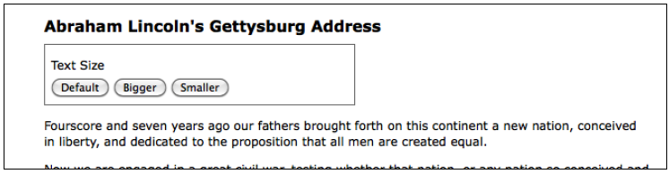
Modifying CSS with inline properties
By linking to a stylesheet with a few basic style rules, the page will initially look like this:
Once we're done with our code, clicking on the Bigger and Smaller buttons will increase or decrease the text size of <div class="speech">, while clicking on the Default button will reset <div class="speech"> to its original text size.

Slide 7
Setting computed style-property values
If all we wanted was to change the font size a single time to a predetermined value, we could still use the .addClass() method. But, let's suppose now that we want the text to continue increasing or decreasing incrementally each time the respective button is clicked. Although it might be possible to define a separate class for each click and iterate through them, a more straightforward approach would be to compute the new text size each time by getting the current size and increasing it by a set factor (for example, 40 percent).
Our code will start with the $(document).ready() and $('#switcher-large').click() event handlers:
$(document).ready(function() {
$('#switcher-large').click(function() {
});
});

Slide 8
Setting computed style-property values
Next, the font size can be easily discovered by using the .css() method: $('div.speech').css('fontSize'). However, the returned value is a string, containing both the numeric font size value and the units of that value (px). We’ll need to strip the unit label off in order to perform calculations with the numeric value. Also, when we plan to use a jQuery object more than once, it's generally a good idea to cache the selector by storing the resulting jQuery object in a variable. We'll take care of these needs with the introduction of a couple of local variables:
$(document).ready(function() {
var $speech = $('div.speech');
$('#switcher-large').click(function() {
var num = parseFloat($speech.css('fontSize'));
});
});

Slide 9
Setting computed style-property values
The first line inside $(document).ready() now creates a variable containing a jQuery object pointing to <div class="speech">. Notice the use of a dollar ($) sign in the variable name, $speech. Since the dollar sign is a legal character in JavaScript identifiers, we can use it as a reminder that the var iable is storing a jQuery object. Unlike in other programming languages such as PHP, the dollar symbol holds no special significance in JavaScript, the language of jQuery.
Inside the .click() handler, we use parseFloat() to get the font size property’s numeric value only. The parseFloat() function looks at a string from the left-hand side to the right-hand side until it encounters a non-numeric character. The string of digits is converted into a floating-point (decimal) number. For example, it would convert the string '12' to the number 12. In addition, it strips non-numeric trailing characters from the string, so '12px' becomes 12 as well. If the string begins with a non-numeric character, parseFloat() returns NaN, which stands for Not a Number.

Slide 10
Setting computed style-property values
All that's left to do is to modify the parsed numeric value and to reset the font size based on the new value. For our example, we'll increase the font size by 40 percent each time the button is clicked. To achieve this, we'll multiply num by 1.4 and then set the font size by concatenating num and 'px':
$(document).ready(function() {
var $speech = $('div.speech');
$('#switcher-large').click(function() {
var num = parseFloat($speech.css('fontSize'));
num *= 1.4;
$speech.css('fontSize', num + 'px');
});
});

Slide 11
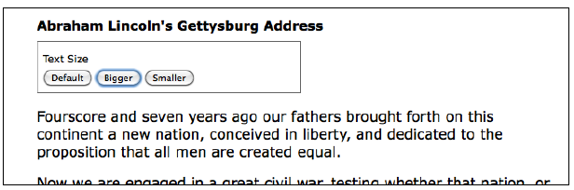
Setting computed style-property values
Now when a user clicks on the Bigger button, the text becomes larger. Another click and the text becomes larger:

Slide 12
Setting computed style-property values
To get the Smaller button to decrease the font size, we will divide rather than multiply: —num /= 1.4. Better still, we'll combine the two into a single .click() handler on all the <button> elements within <div id="switcher">. Then, after finding the numeric value, we can either multiply or divide depending on the ID of the button that was clicked. Listing 4.4 illustrates this.
$(document).ready(function() {
var $speech = $('div.speech');
$('#switcher button').click(function() {
var num = parseFloat($speech.css('fontSize'));
if (this.id == 'switcher-large') {
num *= 1.4;
} else if (this.id == 'switcher-small') {
num /= 1.4;
}
$speech.css('fontSize', num + 'px');
});
});

Slide 13
Setting computed style-property values
Recall from Chapter 3, Handling Events, that we can access the id property of the DOM element referred to by this, which appears here inside the if and else if statements. Here, it is more efficient to use this than to create a jQuery object just to test the value of a property.
It would also be nice to have a way to return the font size to its initial value. To allow the user to do so, we can simply store the font size in a variable immediately when the DOM is ready. We can then restore this value whenever the Default button is clicked. To handle this click event, we could add another else if statement. Instead, though, we will use a switch statement, which is appropriate when we have several cases to handle:
$(document).ready(function() {
var $speech = $('div.speech');
var defaultSize = $speech.css('fontSize');
$('#switcher button').click(function() {
var num = parseFloat($speech.css('fontSize'));
switch (this.id) {
case 'switcher-large’:
num *= 1.4;
break;
case 'switcher-small’:
num /= 1.4;
break;
default:
num = parseFloat(defaultSize);
}
$speech.css('fontSize', num + 'px');
});
});

Slide 14
Setting computed style-property values
Here, we're still checking the value of this.id and changing the font size based on it, but if its value is neither 'switcher-large' nor 'switcher-small', it will default to the initial font size.

Slide 15
Using vendor-specific style properties
When browser vendors introduce experimental style properties, they often prefix the property name until the browser's implementation aligns with the CSS specification. When both the implementation and the specification are stable enough, vendors will shed that prefix and allow the standard name to be used. In a stylesheet, therefore, it is not uncommon to see a set of CSS declarations like the following:
-webkit-property-name: value;
-moz-property-name: value;
-ms-property-name: value;
-o-property-name: value;
property-name: value;
If we wanted to apply the same in JavaScript, we would need to test for the existence of the DOM equivalent of these variations: propertyName, WebkitPropertyName, msPropertyName, and so on. With jQuery, however, we can simply the standard property name, like.css('propertyName', 'value'). If that name is not found as a property of the style object, jQuery loops through the vendor prefixes behind the scenes—Webkit, O, Moz, and ms—and uses the first one it does find as a property, if any.

Slide 16
Hiding and showing elements
The basic .hide() and .show() methods, without any parameters, can be thought of as smart shorthand methods for .css('display', 'string'), where 'string’ is the appropriate display value. The effect, as might be expected, is that the matched set of elements will be immediately hidden or shown with no animation.
The .hide() method sets the inline style attribute of the matched set of elements to display: none. The smart part here is that it remembers the value of the display property—typically block, inline, or inline-block—before it was changed to none. Conversely, the .show() method restores the display properties of the matched set of elements to whatever they initially were before display: none was applied.
This feature of .show() and .hide() is especially helpful when hiding elements that have had their default display property overridden in a stylesheet. For example, the <li> element has the property display: list-item by default, but we might want to change it to display: inline for a horizontal menu. Fortunately, using the .show() method on a hidden element such as one of the <li> tags would not merely reset it to its default display: list-item, because that would put the <li> tag on its own line. Instead, the element is restored to its previous display: inline state, thus preserving the horizontal design.

Slide 17
Hiding and showing elements
The basic .hide() and .show() methods, without any parameters, can be thought of as smart shorthand methods for .css('display', 'string'), where 'string’ is the appropriate display value. The effect, as might be expected, is that the matched set of elements will be immediately hidden or shown with no animation.
The .hide() method sets the inline style attribute of the matched set of elements to display: none. The smart part here is that it remembers the value of the display property—typically block, inline, or inline-block—before it was changed to none. Conversely, the .show() method restores the display properties of the matched set of elements to whatever they initially were before display: none was applied.
This feature of .show() and .hide() is especially helpful when hiding elements that have had their default display property overridden in a stylesheet. For example, the <li> element has the property display: list-item by default, but we might want to change it to display: inline for a horizontal menu. Fortunately, using the .show() method on a hidden element such as one of the <li> tags would not merely reset it to its default display: list-item, because that would put the <li> tag on its own line. Instead, the element is restored to its previous display: inline state, thus preserving the horizontal design.

Slide 18
Hiding and showing elements
We can set up a quick demonstration of these two methods by working with a second paragraph and adding a read more link after the first paragraph in the example HTML:
<div class="speech">
<p>Fourscore and seven years ago our fathers brought forth
on this continent a new nation, conceived in liberty,
and dedicated to the proposition that all men are
created equal.
</p>
<p>Now we are engaged in a great civil war, testing whether
that nation, or any nation so conceived and so dedicated,
can long endure. We are met on a great battlefield of
that war. We have come to dedicate a portion of that
field as a final resting-place for those who here gave
their lives that the nation might live. It is altogether
fitting and proper that we should do this. But, in a
larger sense, we cannot dedicate, we cannot consecrate,
we cannot hallow, this ground.
</p>
<a href="#" class="more">read more</a>
...
</div>

Slide 19
Hiding and showing elements
When the DOM is ready, we select an element and call .hide() on it:
$(document).ready(function() {
$('p').eq(1).hide();
});

Slide 20
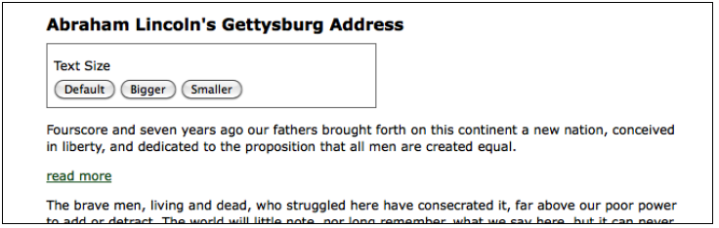
Hiding and showing elements
The .eq() method is similar to the :eq() pseudo-class discussed in Chapter 2, Selecting Elements. It returns a jQuery object pointing to a single element at the provided zero-based index. In this case, the method selects the second paragraph and hides it, so that the read more link appears immediately following the first paragraph:

Slide 21
Hiding and showing elements
When the user clicks on read more at the end of the first paragraph, we call .show() to display the second paragraph and .hide() to hide the clicked link:
$(document).ready(function() {
$('p').eq(1).hide();
$('a.more').click(function(event) {
event.preventDefault();
$('p').eq(1).show();
$(this).hide();
});
});

Slide 22
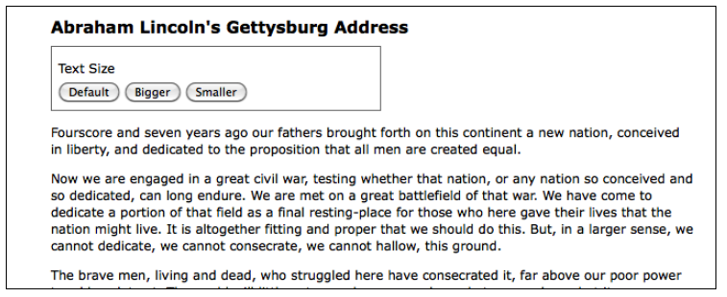
Hiding and showing elements
Note the use of .preventDefault() to keep the link from activating its default action. Now the speech looks like this:
The .hide() and .show() methods are quick and useful, but they aren't very flashy. To add some flair, we can give them a duration.

Slide 23
Effects and duration
When we include a duration (sometimes also referred to as a speed) with .show() or .hide(), it becomes animated—occurring over a specified period of time. The .hide(duration) method, for example, decreases an element's height, width, and opacity simultaneously until all three reach zero, at which point the CSS rule display: none is applied. The .show(duration) method will increase the element’s height from top to bottom, width from the left-hand side to the right-hand side, and opacity from 0 to 1 until its contents are completely visible.

Slide 24
Speeding in
With any jQuery effect, we can use one of the two preset speeds, 'slow' or 'fast’. Using .show('slow') makes the show effect complete in 600 milliseconds (0.6 seconds), .show('fast') in 200 milliseconds. If any other string is supplied, jQuery’s default animation duration of 400 milliseconds will be used. For even greater precision, we can specify a number of milliseconds: for example, .show(850). Note that in this case we are specifying a numeric value, so we do not use quotation marks.
Let's include a speed in our example when showing the second paragraph of Lincoln's Gettysburg Address:
$(document).ready(function() {
$('p').eq(1).hide();
$('a.more').click(function(event) {
event.preventDefault();
$('p').eq(1).show('slow');
$(this).hide();
});
});

Slide 25
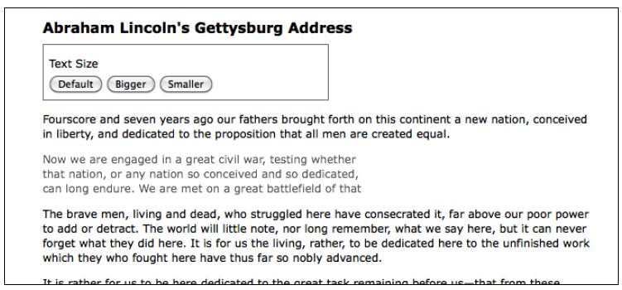
Speeding in
When we capture the paragraph's appearance at roughly halfway through the effect, we see the following:

Slide 26
Fading in and fading out
While the animated .show() and .hide() methods are certainly flashy, in practice, they animate more properties than are useful. Fortunately, jQuery offers a couple of other prebuilt animations for a more subtle effect. For example, to have the whole paragraph appear just by gradually increasing the opacity, we can use .fadeIn('slow') instead:
$(document).ready(function() {
$('p').eq(1).hide();
$('a.more').click(function(event) {
event.preventDefault();
$('p').eq(1).fadeIn('slow');
$(this).hide();
});
});

Slide 27
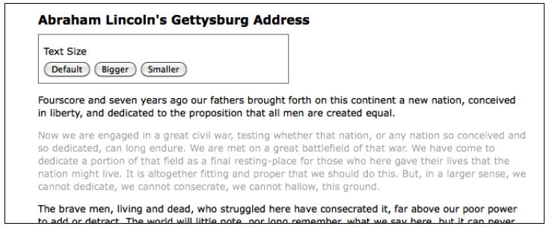
Fading in and fading out
Now when we look at the paragraph during the effect, it looks like this:
The difference here is that the .fadeIn() effect starts by setting the dimensions of the paragraph so that the contents can simply fade into it. To gradually decrease the opacity we can use .fadeOut().

Slide 28
Sliding up and sliding down
The fading animations are very useful for items that are outside the flow of the document. For example, these are typical effects to apply to "lightbox" elements that are overlaid on the page. However, when an element is part of the document flow, calling .fadeIn() on it causes the document to jump to provide the real estate needed for the new element, which is not always aesthetically pleasing. In these cases, jQuery's .slideDown() and .slideUp() methods are often the right choice. These effects animate only the height of the selected elements. To have our paragraph appear using a vertical slide effect, we can call .slideDown('slow'):
$(document).ready(function() {
$('p').eq(1).hide();
$('a.more').click(function(event) {
event.preventDefault();
$('p').eq(1).slideDown('slow');
$(this).hide();
});
});

Slide 29
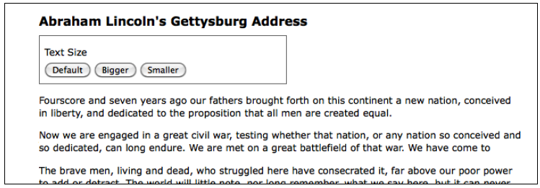
Sliding up and sliding down
This time when we examine the paragraph at the animation's midpoint, we see the following:
To reverse the effect, we would instead call .slideUp().

Slide 30
Toggling visibility
Sometimes we have a need to toggle the visibility of elements, rather than displaying them once as we have done in the previous examples. This toggling can be achieved by first checking the visibility of the matched elements and then calling the appropriate method. Using the fade effects again, we can modify the example script to look like this:
$(document).ready(function() {
var $firstPara = $('p').eq(1);
$firstPara.hide();
$('a.more').click(function(event) {
event.preventDefault();
if ($firstPara.is(':hidden')) {
$firstPara.fadeIn('slow’);
$(this).text('read less');
} else {
$firstPara.fadeOut('slow’);
$(this).text('read more’);
}
});
});

Slide 31
Toggling visibility
Sometimes we have a need to toggle the visibility of elements, rather than displaying them once as we have done in the previous examples. This toggling can be achieved by first checking the visibility of the matched elements and then calling the appropriate method. Using the fade effects again, we can modify the example script to look like this:
As we did earlier in the chapter, we're caching our selector here to avoid repeated DOM traversal. Notice too that we're no longer hiding the clicked link; instead, we’re changing its text.
$(document).ready(function() {
var $firstPara = $('p').eq(1);
$firstPara.hide();
$('a.more').click(function(event) {
event.preventDefault();
if ($firstPara.is(':hidden')) {
$firstPara.fadeIn('slow’);
$(this).text('read less');
} else {
$firstPara.fadeOut('slow’);
$(this).text('read more’);
}
});
});

Slide 32
Toggling visibility
Using an if-else statement is a perfectly reasonable way to toggle elements’ visibility. But with jQuery's compound effect methods, we can remove some conditional logic from our code. jQuery provides a .toggle() method, which acts like .show() and .hide(), and like them, it can be used with or without a duration argument. Other compound methods include .fadeToggle() and .slideToggle(), which show or hide elements using the corresponding effects. Here is what the script looks like when we use the .slideToggle() method:
To reduce repetition of $(this), we're storing the result in the $link variable for performance and readability. Also, the conditional statement checks for the text of the link rather than the visibility of the second paragraph, since we're only using it to change the text.
$(document).ready(function() {
var $firstPara = $('p').eq(1);
$firstPara.hide();
$('a.more').click(function(event) {
event.preventDefault();
$firstPara.slideToggle('slow');
var $link = $(this);
if ($link.text() == 'read more') {
$link.text('read less');
} else {
$link.text('read more');
}
});
});

Slide 33
Summary

